Slide 1




(Web3, Decentralization, Blockchain, NFTs, Tekonomics, DAOs, etc.).
Maheshkumar Rajarathinavel
Solution Architect - Apps & Cloud native
Microsoft India
https://www.linkedin.com/in/mfcmahesh/
MahesKBlr

Slide 2
Disclaimer
This session offers my personal insights on Web3 and not from my employer any means.
I m not an analyst or web3/4/5/{n} ….. ninja ☺
My views might be different or opposite of what others follow
Its my personal learning sourced from twitter, reddit forum, 3’rd party report
This content is sourced from public internet including images. I would pass the credit to the owners and its not mine. Thkx!
Share your thoughts in chat/raise hand
MahesKBlr

Slide 3
Web3 - Background
Web3 is a vision for the future internet, powered by decentralized blockchains, owned by the builders and users.
Web3 is inclusive of mechanisms built on blockchain, including cryptocurrencies, smart contracts, decentralized apps (dApps), and non-fungible tokens (NFTs)
Decentralization removes the need for third parties and empowers users.
MahesKBlr

Slide 4
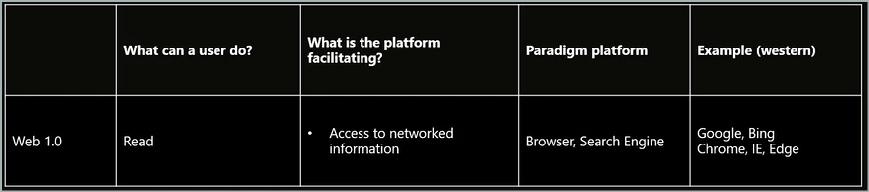

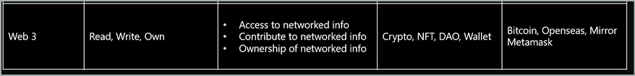
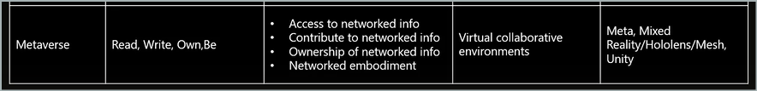
What is Web3 really ?
MahesKBlr

Slide 5

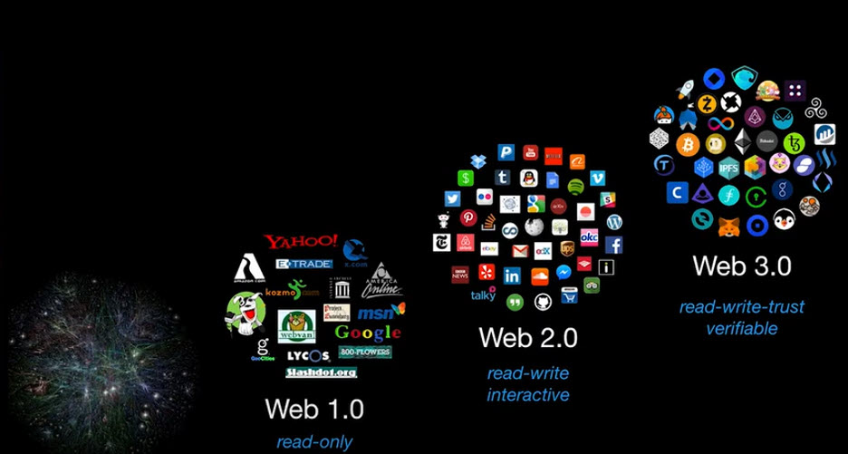

Slide 6
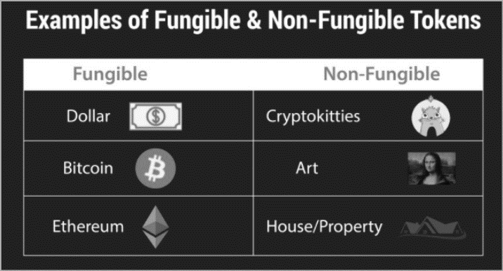
Web3 and NFT
Easily exchangeable and individually unique digital assets which are held on certain blockchains, mainly Ethereum but also others such as Flow, Wax, and many others.
MahesKBlr

Slide 7
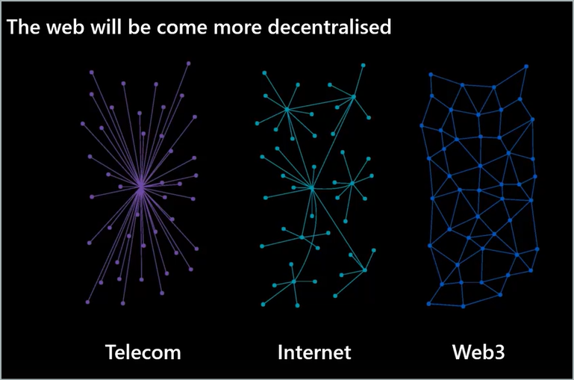
MahesKBlr

Slide 8
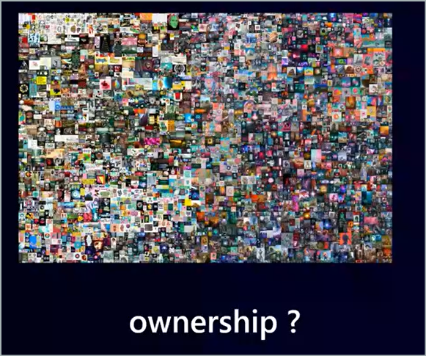
MahesKBlr

Slide 9
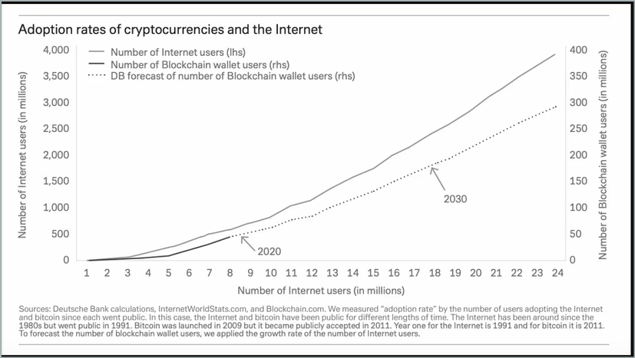
MahesKBlr

Slide 10
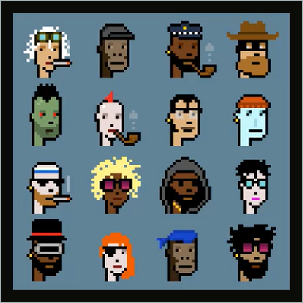
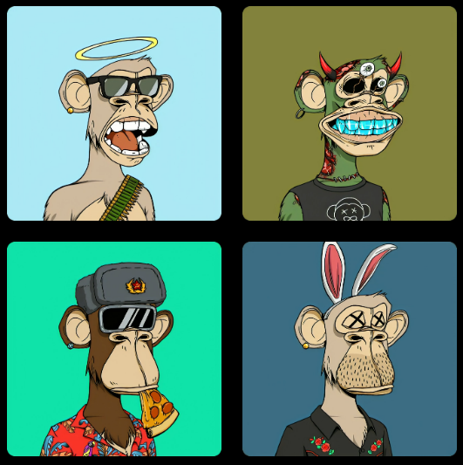
Do you want to own this one?
Bored Ape Yacht Club issued a series of NFTs on Ethereum that generated intense speculation
MahesKBlr

Slide 11
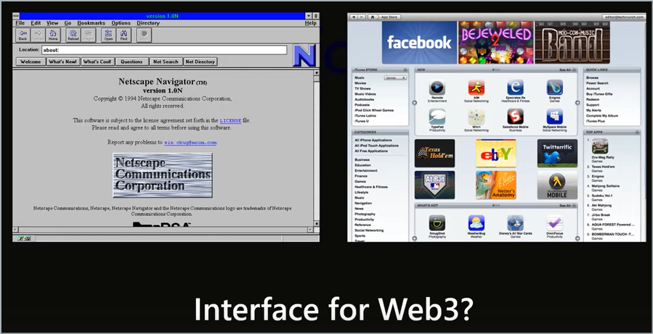
MahesKBlr

Slide 12
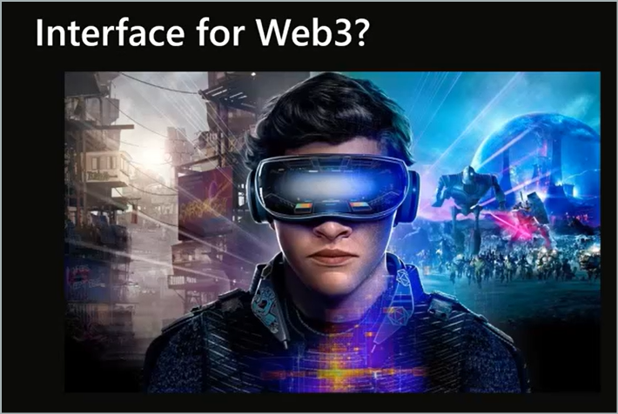
MahesKBlr

Slide 13
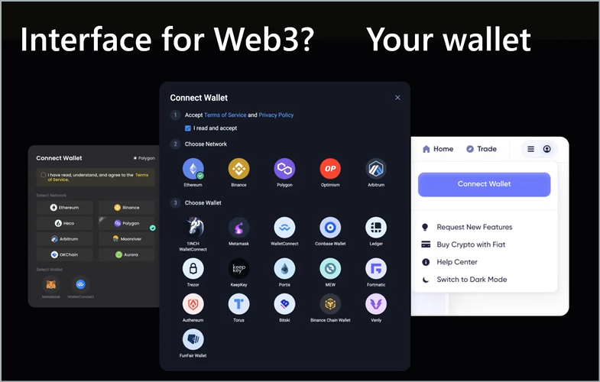
MahesKBlr

Slide 14
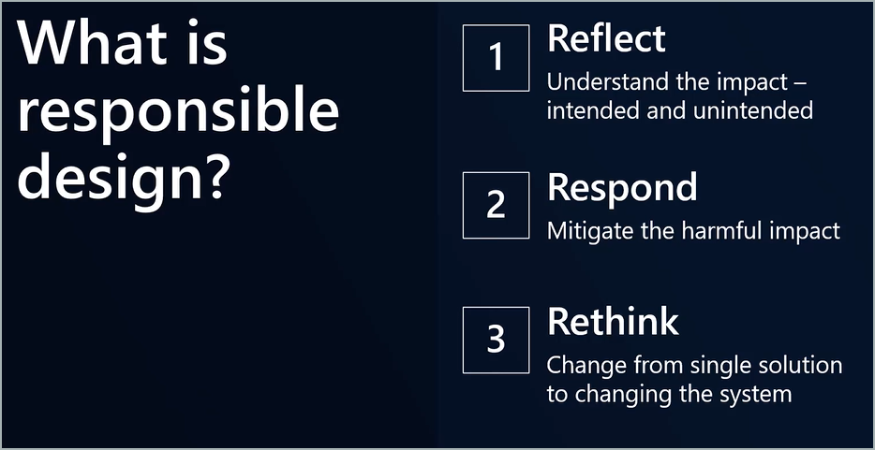
MahesKBlr

Slide 15
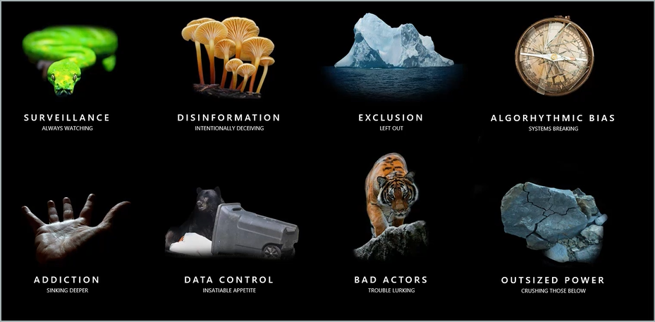
MahesKBlr

Slide 16
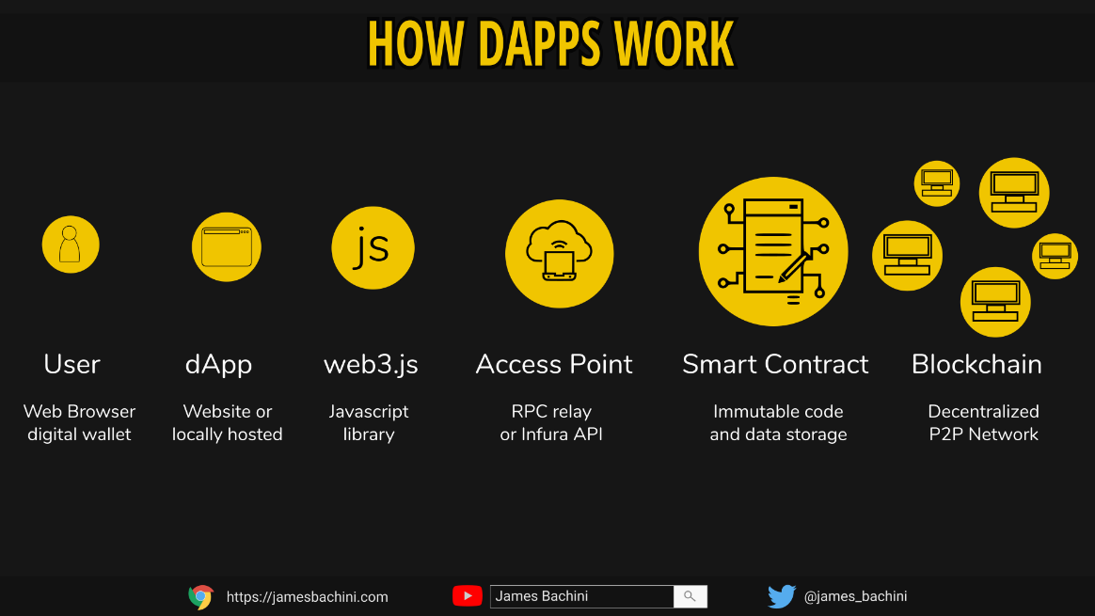
Technologies & Concepts – Blockchain
Web3 uses a stack of technologies based on decentralized blockchains
Distributed across thousands of computers rather than centralized servers, blockchains will enable new business and social models.
Users own their data, identity, content and algorithms and participate as “shareholders” by owning a protocol’s tokens or cryptocurrencies.
dApps are stored and executed on blockchains rather than centralized servers and allow users to execute smart contracts without a single point of failure.
MahesKBlr

Slide 17
What is beyond Digital Art
NFTs have garnered a lot of attention in the art and entertainment world.
But with the emergence of Web3 and the Metaverse, the increased consumer appetite for virtual merchandise, and the shift towards the idea of digital ownership, NFTs are expanding way beyond digital art.
We’re starting to see it spread into music, entertainment, sports, and live events—and provide value and utility beyond simply a digital collectible.

Slide 18
Sample use case
Ensuring authenticity of products: Imagine a world where you can scan a QR code for a product you bought online and see its entire journey from manufacturing to shipping.
Real estate: NFTs can be used to transfer land deeds, provide proof of ownership, and even keep track of changes in property value over time.
Verified vehicle history: NFTs can be the auto industry’s solution to misleading or altered vehicle history reports. Incorporating NFTs and blockchain technology into their vehicles means that future buyers have full transparency into the history of a vehicle and can make a more confident used car purchase.
Supply chain: NFTs can give companies the ability to track their products from manufacturing through shipping and delivery. This gives customers insight into what they are spending money on as well as maintaining transparency within a company’s supply chain.
Ticketing: NFTs can solve issues related to fraud and paper usage for ticketing—whether that’s for concerts, sporting events, or even parking passes
MahesKBlr

Slide 19
What area tokenomics?
DEFI - users are rewarded with tokens for activity (borrowing/lending), or tokens are created as synthetic versions of other existing cryptocurrencies
DAOs - token holders get voting rights within Decentralized Autonomous Organizations, new digital communities governed by Smart Contracts
Gaming/Metaverse - where game activity and in-game items are represented by tokens and can have exchangeable value
MahesKBlr

Slide 20
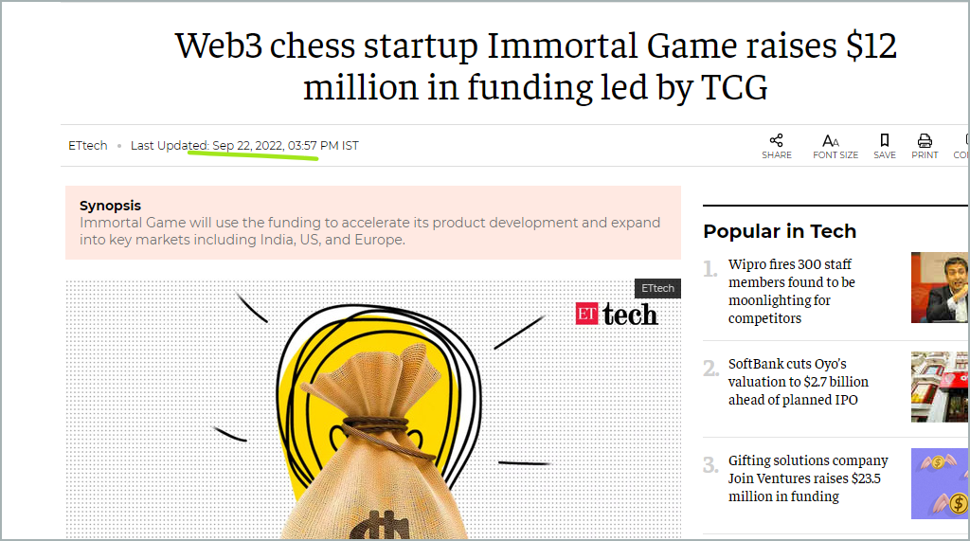
https://economictimes.indiatimes.com/tech/funding/web3-chess-startup-immortal-game-raises-12-million-in-funding-led-by-tcg/articleshow/94374372.cms
MahesKBlr

Slide 21
Microsoft Cloud provides the most comprehensive set of capabilities to power metaverses that blend the physical and digital worlds
IoT capabilities enable customers to create digital twins of physical objects in the cloud; utilize Microsoft Mesh to build a shared sense of presence across devices; and use AI‐powered resources to create natural interactions through speech and vision machine learning models.
In gaming we have created community through franchises like Halo, Minecraft and Flight Simulator and will continue to invest to enable creators to build the best experiences across our platforms.
Two products recently announced that will begin to enable metaverse experiences at scale in the enterprise include:
Dynamics 365 Connected Spaces: Now in preview, this product provides a new perspective on the way people move and interact with nearly any space, from the retail store to the factory floor, and how they manage health and safety in a hybrid work environment.
Mesh for Microsoft Teams: This bridging of communication methods makes human presence the ultimate connection. Now, everyone in a meeting can be present without being physically present using personalized avatars and immersive spaces that can be accessed from any device, with no special equipment needed.
https://aka.ms/CSIgnite21
https://aka.ms/AAdv6cd
MahesKBlr

Slide 22
tldr
Web3 is attracting a lot of hype and investment, but the infrastructure remains disjointed, and it currently exists mostly as a concept. A breakthrough may lie on the other side of the hype.
Significant widespread development, consolidation, and accessibility efforts are needed before the Web3 vision is realized.
Web3 will only become a widespread phenomenon if the underlying technologies are simple enough for any user to adopt them without having to worry about the complexities of crypto wallets or the risk of NFTs being stolen.
MahesKBlr

Slide 23
challenges
Some see Web3 as a crypto rebranding that will centralize control in different ways.
The technologies and frameworks remain cumbersome and susceptible to fraud.
Web3 technology adoption remains low as use cases continue to emerge.
Web3 is entirely reliant upon blockchain technology and cryptocurrencies will play a major role, many of the same environmental concerns regarding emissions from crypto mining need to be addressed. Sustainability will be key.
MahesKBlr

Slide 24
What’s next
“Web3” is often used as a catchall by the media for anything related to blockchain, cryptocurrency, NFTs, and the metaverse, which includes other technologies unrelated to distributed ledgers.
Web3 concepts of decentralization, ownership, and data portability may one day form the foundations of the metaverse.
MahesKBlr

Slide 25

Let’s discuss
MahesKBlr
https://www.linkedin.com/in/mfcmahesh/

